Slide 1

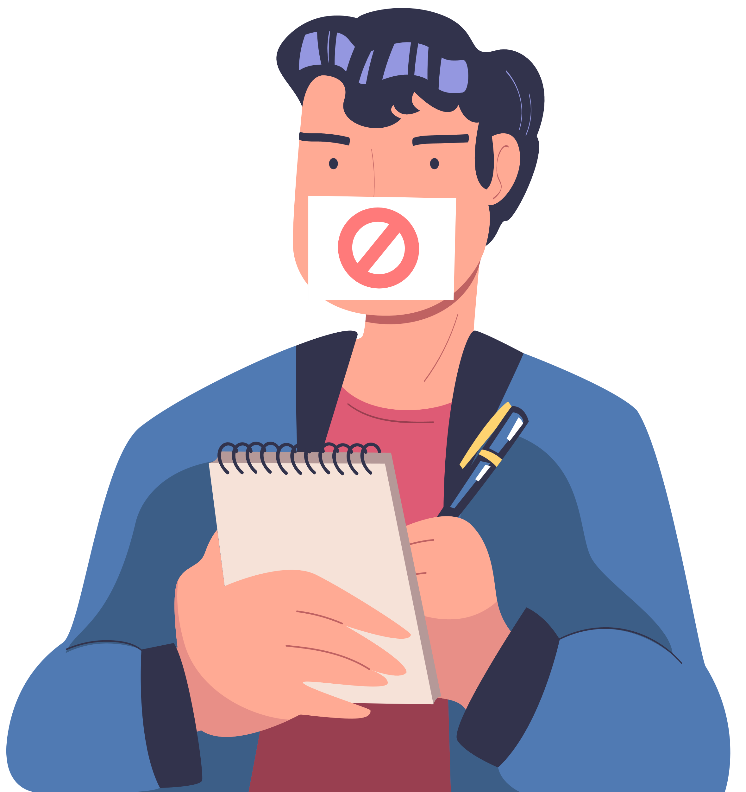
CHALLENGING THE MYTHS ABOUT PARTICAPTION

Slide 2
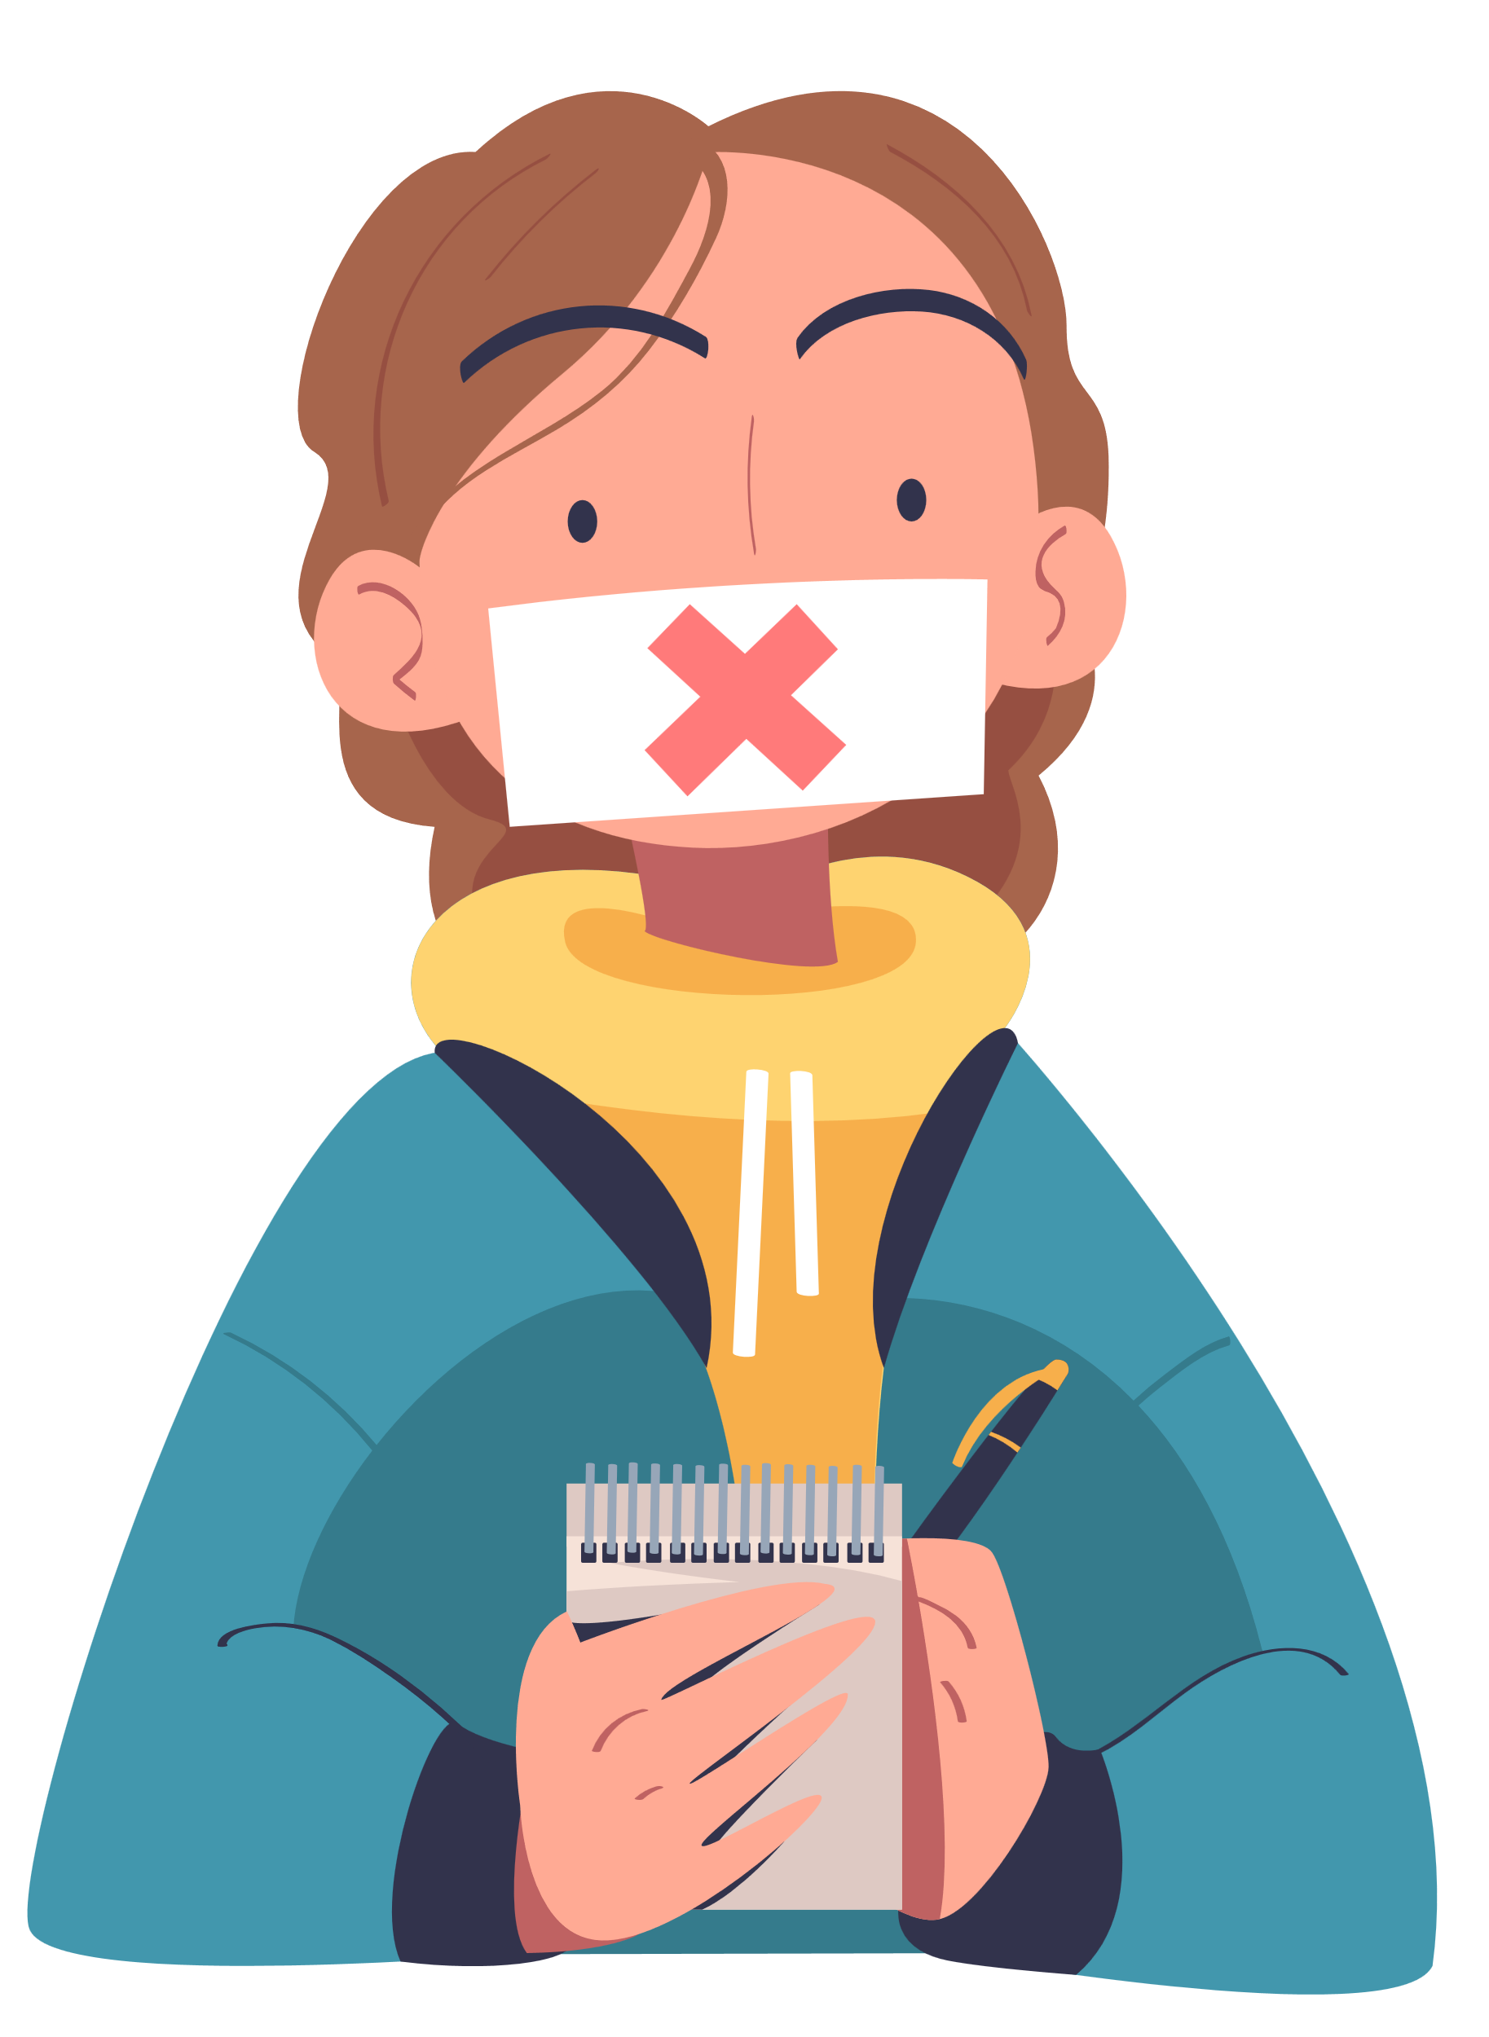

ICEBREAKER
TRUE
FALSE

Slide 3
MYTH 1
‘ADULTS KNOW BEST’
You don’t need to ask children what they think, because adults know best.
TRUE
FALSE
Notes:
Facilitator Note:
This myth is one that many young people have heard before, sometimes even from teachers or adults they trust.
It’s false because adults can’t know what children think, feel or need unless they ask. Adults might have experience, but they don’t live in children’s shoes.
If they don’t ask, they’ll miss things that really matter.
Prompt:
“Have you ever heard someone say this? What would you say back?”

Slide 4
FALSE!
Adults might have experience, but they don’t live in children’s shoes.
If they don’t ask, they’ll miss things that really matter.

Slide 5
MYTH 2
‘THEY ARE TOO YOUNG’
Children are too young to have a real opinion about important things.
TRUE
FALSE
Notes:
Facilitator Note:
This myth is often used to shut down children’s voices, especially younger ones.
It’s false because all children, even very young ones, can have thoughts and feelings about what affects them.
You don’t need to use big words or understand everything to have something important to say.

Slide 6
FALSE!
This myth is often used to shut down children’s voices. All children, even very young ones, can have thoughts and feelings about what affects them.
You don’t need big words to say something important.

Slide 7
MYTH 3
‘THEY WON’T UNDERSTAND’
There’s no point asking some young people. They won’t understand what’s going on.
FAIR
UNFAIR
Notes:
Facilitator Note:
This myth is often used to ignore the voices of young people with learning difficulties or disabilities.
But understanding comes in different ways.
Some people use words, others use pictures, signs or actions.
What matters is finding the right way to include everyone. Every young person has the right to be heard.
If something affects them, they should have the chance to be involved — and the support they need to take part.
🧭 Link to Lundy quadrant: Voice
Case Study:
Imagine a school is planning changes to break times.
They hold a meeting with the student council but don’t invite any students with additional learning needs because they assume those students won’t understand the discussion.
The result?
The views of those who may find busy break times hardest are left out.
The changes might make things worse for them.
Prompt:
“Is that fair? What do you think?”

Slide 8
UNFAIR
Understanding comes in different ways. Some people use words, others use pictures, signs or actions.
What matters is finding the right way to include everyone.

Slide 9
MYTH 4
‘THEY ARE NOT REPRESENTATIVE’
There’s no point listening to a few young people, Because They don’t speak for everyone.
FAIR
UNFAIR
Notes:
This myth can be used to ignore young people’s voices just because they are not part of a big group.
But every child has the right to be heard, even if they are the only one speaking.
No group speaks for everyone.
The important thing is to make space for different views and to include a range of experiences where you can.
In research, some adults say findings do not count unless the group is fully representative.
That can be important in some situations, but it can also be used to dismiss what young people are saying.
Listening to a small group is not perfect, but it is always better than ignoring them altogether.
It is not always possible to include everyone, but that is not a reason to stop listening.

Slide 10
UNFAIR!
Every child has the right to be heard, even if they are the only one speaking. No group speaks for everyone.
Listening to a small group is always better than ignoring them altogether.

Slide 11
MYTH 5
‘IT COST TOO MUCH AND TAKES TOO LONG’
We can’t ask young people what they think. It costs too much and takes too long.
FAIR
UNFAIR
Notes:
Facilitator Note:
Some adults say this when they don’t want to make time to listen to children.
Some make it sound like listening to young people is a luxury.
But it is not. It is a right.
There are quick, simple and low-cost ways to involve children in decisions.
And when you do, it often saves time and money by avoiding mistakes or misunderstandings later.
Prompt:
“Is that fair? What do you think?”

Slide 12
UNFAIR
Listening to young people is not a luxury, it’s a right.
There are quick and low-cost ways to involve children.

Slide 13





INFORM
INSPIRE
FOR MORE INFORMATION
EMPOWER
07846 137 597
www.priority154.com
john.khan@priority154.com

Slide 14
MYTH BUSTING
TRUE
FALSE

Slide 15

INSTRUCTIONS
01
Read the statement on the screen carefully.
02
Take time to discuss WHAT YOU THINK ABOUT EACH MYTH.
03
Walk to the side of the room that matches your choice.
This resource has been adapted with kind permission from Professor Laura Lundy (2025).

Slide 16
MYTH 1
‘ADULTS KNOW BEST’
You don’t need to ask children what they think, because adults know best.
TRUE
FALSE
Notes:
Facilitator Note:
This myth is one that many young people have heard before, sometimes even from teachers or adults they trust.
It’s false because adults can’t know what children think, feel or need unless they ask. Adults might have experience, but they don’t live in children’s shoes.
If they don’t ask, they’ll miss things that really matter.
Prompt:
“Have you ever heard someone say this? What would you say back?”

Slide 17
FALSE!
Adults might have experience, but they don’t live in children’s shoes.
If they don’t ask, they’ll miss things that really matter.

Slide 18
MYTH 2
‘THEY ARE TOO YOUNG’
Children are too young to have a real opinion about important things.
TRUE
FALSE
Notes:
Facilitator Note:
This myth is often used to shut down children’s voices, especially younger ones.
It’s false because all children, even very young ones, can have thoughts and feelings about what affects them.
You don’t need to use big words or understand everything to have something important to say.

Slide 19
FALSE!
This myth is often used to shut down children’s voices. All children, even very young ones, can have thoughts and feelings about what affects them.
You don’t need big words to say something important.

Slide 20
MYTH 3
‘THEY WON’T UNDERSTAND’
There’s no point asking some young people. They won’t understand what’s going on.
FAIR
UNFAIR
Notes:
Facilitator Note:
This myth is often used to ignore the voices of young people with learning difficulties or disabilities.
But understanding comes in different ways.
Some people use words, others use pictures, signs or actions.
What matters is finding the right way to include everyone. Every young person has the right to be heard.
If something affects them, they should have the chance to be involved — and the support they need to take part.
🧭 Link to Lundy quadrant: Voice
Case Study:
Imagine a school is planning changes to break times.
They hold a meeting with the student council but don’t invite any students with additional learning needs because they assume those students won’t understand the discussion.
The result?
The views of those who may find busy break times hardest are left out.
The changes might make things worse for them.
Prompt:
“Is that fair? What do you think?”

Slide 21
UNFAIR
Understanding comes in different ways. Some people use words, others use pictures, signs or actions.
What matters is finding the right way to include everyone.

Slide 22
MYTH 4
‘IT COST TOO MUCH AND TAKES TOO LONG’
we can’t ask young people what they think. It costs too much and takes too long.
FAIR
UNFAIR
Notes:
Facilitator Note:
Some adults say this when they don’t want to make time to listen to children.
Some make it sound like listening to young people is a luxury.
But it is not. It is a right.
There are quick, simple and low-cost ways to involve children in decisions.
And when you do, it often saves time and money by avoiding mistakes or misunderstandings later.
Prompt:
“Is that fair? What do you think?”

Slide 23
UNFAIR
Listening to young people is not a luxury, it’s a right.
There are quick and low-cost ways to involve children.

Slide 24
MYTH 5
‘THEY ARE NOT REPRESENTATIVE’
There’s no point listening to a few young people, Because They don’t speak for everyone.
FAIR
UNFAIR
Notes:
This myth can be used to ignore young people’s voices just because they are not part of a big group.
But every child has the right to be heard, even if they are the only one speaking.
No group speaks for everyone.
The important thing is to make space for different views and to include a range of experiences where you can.
In research, some adults say findings do not count unless the group is fully representative.
That can be important in some situations, but it can also be used to dismiss what young people are saying.
Listening to a small group is not perfect, but it is always better than ignoring them altogether.
It is not always possible to include everyone, but that is not a reason to stop listening.

Slide 25
UNFAIR!
Every child has the right to be heard, even if they are the only one speaking. No group speaks for everyone.
Listening to a small group is always better than ignoring them altogether.

Slide 26
MYTH 6
‘THEY ARE TOO VULNERABLE’
Some young people are going through too much. It is better not to involve them.
TRUE
FALSE
Notes:
Facilitator Note:
This myth is based on the idea that being vulnerable means you should be left out of decisions.
But the opposite is often true.
Young people who are going through a hard time need to be heard even more, not less.
Leaving someone out can make them feel even more invisible or powerless.
The key is to make it safe, build trust and give support so that they can take part in a way that feels okay for them.
🧭 Link to Lundy quadrant: Space

Slide 27
FALSE
Being vulnerable doesn’t mean you should be left out. It means being heard is even more important.
Feeling safe and supported can help young people take part in a way that works for them.

Slide 28
MYTH 7
‘PARTICIPATION VERSUS PROTECTION’
Young people should be protected from difficult topics by keeping them out of it.
TRUE
FALSE
Notes:
Facilitator Note:
This myth is about protecting children by excluding them from involvement or decision-making altogether.
But you can’t protect and keep children safe properly without listening to them.
Equally, they won’t speak openly and honestly if they don’t feel safe.
Protection and participation go hand in hand.
Link to Lundy quadrant: Space

Slide 29
FALSE!
You can’t protect children properly without listening to them. And they won’t speak openly unless they feel safe.
Being safe and being heard go together.

Slide 30
MYTH 8
‘IT’S TOO SENSITIVE’
Some things are too upsetting or difficult to talk about with young people.
FAIR
UNFAIR
Notes:
Facilitator Note:
This myth says it is better not to ask children about certain topics because it might upset them.
But if something affects young people, they have a right to be heard — even on sensitive or challenging issues.
Avoiding hard topics may feel safe, but it can lead to silence and misunderstanding.
Adults sometimes avoid asking because they are worried about saying the wrong thing or triggering difficult emotions.
Not asking does not protect young people — it just means adults miss the chance to understand what they’re going through.
The safest and most respectful way to explore sensitive topics is to involve young people in deciding how those conversations happen — and to listen carefully.
🧭 Link to Lundy quadrant: Voice

Slide 31
FALSE!
Avoiding sensitive issues doesn’t protect young people but can leave them feeling alone and isolated.
The safest way to talk is to ask young people how.

Slide 32
MYTH 9
‘CHILDREN ARE THE EXPERTS IN THEIR OWN LIVES’
Children always know exactly what’s best for them, better than anyone else.
TRUE
FALSE
Notes:
Facilitator Note:
This myth sounds like it’s standing up for children, but it takes things too far.
Yes, children are experts in their own experiences, but that doesn’t mean they always know exactly what’s best for them in every situation.
Adults and children need to work together.
Adults bring experience and support, and children bring their own views and lived experience.
Both matter.

Slide 33
FALSE!
YOUNG PEOPLE are experts in their own experiences, but that doesn’t mean they always know what’s best in every situation.
Adults and children need to work together, BECAUSE both bring something important.

Slide 34
MYTH 10
‘CHILDREN ARE THE FUTURE’
We don’t need to listen to young people now. They’ll have their say when they’re older.
AGREE
DISAGREE
Notes:
Facilitator Note:
This might sound like a compliment, but it still treats young people as if they only matter later.
Some adults say this when they want to sound supportive, but still avoid listening.
They have the right to be heard about things that affect them today, not just when they are older.

Slide 35
UNFAIR
YOUNG PEOPLE HAVE THE RIGHT TO BE HEARD ABOUT THINGS THAT AFFECT THEM TODAY, not just when they are older.

Slide 36
MYTH 11
‘WE NEED TO ‘GIVE’ THEM A VOICE’
Young people need adults to give them a voice.
AGREE
DISAGREE
Notes:
Facilitator Note:
This myth sounds supportive, but it gets things the wrong way round.
Young people already have a voice.
The real issue is whether adults are listening.
Adults don’t need to give children a voice.
They just need to take what young people say seriously.
And create the space, time and respect for them to be heard.
🧭 Link to Lundy quadrant: Voice
Prompt:
“What do you think adults really mean when they say this? Have you heard it before?”

Slide 37
DISAGREE
Young people already have a voice. The real problem is whether adults are listening.

Slide 38
MYTH 12
‘IT WOULD BE TOKENISTIC’
There’s no point asking young people, because it’s never going to lead to real change.
AGREE
DISAGREE
Notes:
Facilitator Note:
“If we involve young people, it will just be for show and won’t actually change anything.”
It’s a human right, so this should never be an excuse for doing nothing.
Participation is never perfect. Adults need to do their best with what resources they have, and keep improving.

Slide 39
DISAGREE
It’s a human right, so this should never be an excuse for doing nothing.
Participation is never perfect.
Adults need to do their best with what resources they have and keep improving.

Slide 40
LET’S RELFECT!
Consider the following questions:
  What myth surprised you the most?
  Why did it surprise or stand out to you?
  What does it reveal about how adults listen to young people?

Slide 41
THE END!
THANKS FOR TAKING PART!

Slide 42
INFORM
INSPIRE
FOR MORE INFORMATION
EMPOWER
07846 137 597
www.priority154.com
john.khan@priority154.com

