Slide 1

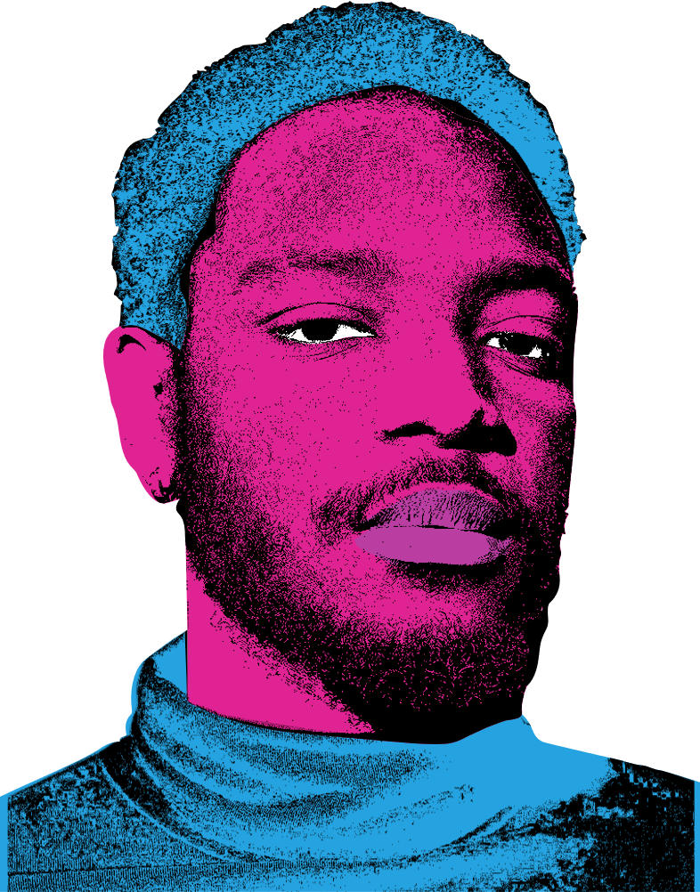
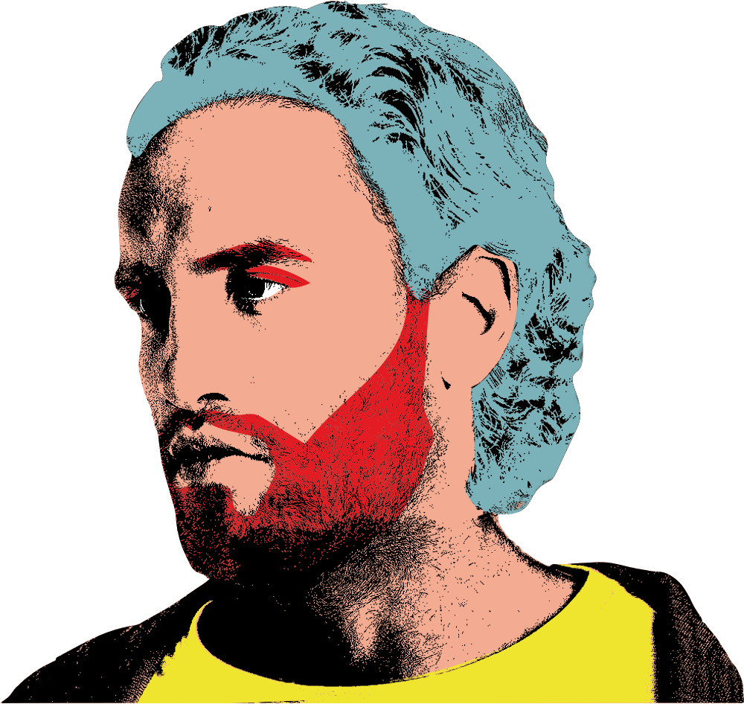
BEHIND THE LOOKSMAXXING TREND
QUIZ
PLAY NOW

Slide 2
LEARNING OUTCOMES
Understand some of the key words and ideas linked to looksmaxxing
Critically think how social media, comparison and online cultures can shape confidence and self-image
Reflect on what actually builds healthy, lasting self-confidence
Notes:
Facilitator notes:
Briefly frame the session: this is not about telling them what to think, but helping them understand and question what they see online
Emphasise this is about confidence, not just appearance
Keep tone open and non-judgemental

Slide 3
INSTRUCTIONS
Work in pairs or small groups and discuss your answer for each question
Be ready to explain your choice and discuss your thinking in the group
Listen to other people’s ideas and be open to changing your mind
Notes:
Facilitator notes:
Reinforce this is a discussion-based quiz, not a test
Encourage disagreement, but keep it respectful
Make it clear they’ll be asked to explain their thinking

Slide 4
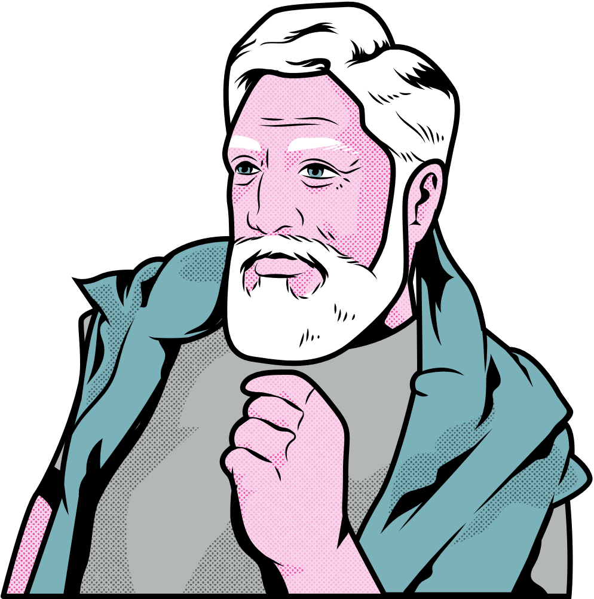
ROUND 1
Terminology
Notes:
Facilitator notes:
Explain this round is about understanding the language they might already see online
Acknowledge some may already know these terms
Keep pace fairly quick, but pause where needed

Slide 5
MULTIPLE CHOICE
Q1. What is “looksmaxxing”
a) Improving your appearance and confidence
b) Competing to look better than others
c) Editing your photos online
Notes:
Answer: b) Competing to look better than others
Facilitator notes:
Many will pick “improving appearance” – explore why that feels right
Clarify: it often goes beyond self-care into comparison and competition
Prompt: “What’s the difference between improving yourself and competing with others?”

Slide 6
MULTIPLE CHOICE
Q1. What is “looksmaxxing”
a) Improving your appearance and confidence
b) Competing to look better than others
c) Editing your photos online

Slide 7
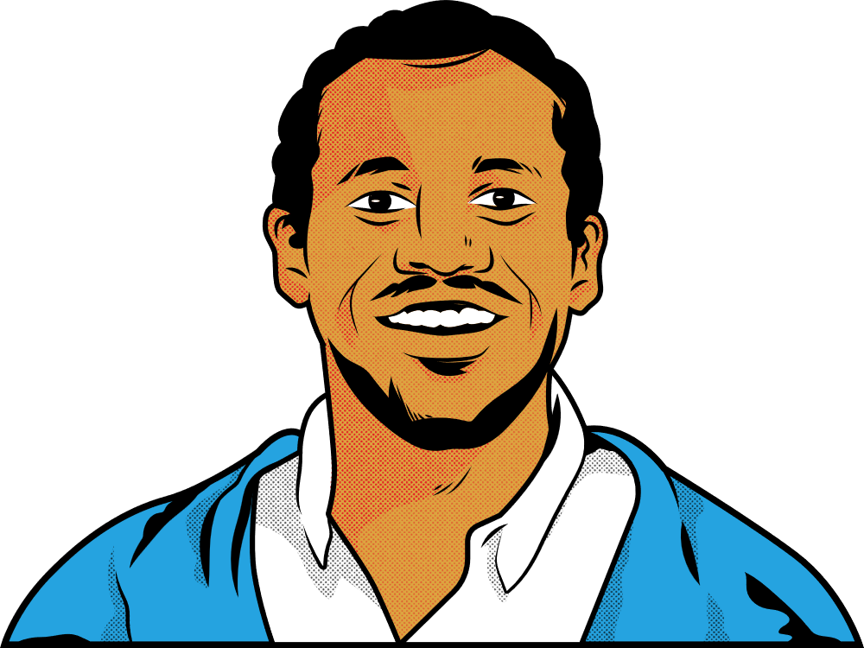
TRUE OR FALSE
Q2. Looksmaxxing always leads to better self-confidence?
TRUE
FALSE
Notes:
Answer: False
Facilitator notes:
Ask: “Why might it not improve confidence?”
Draw out: comparison, pressure, never feeling “enough”
Link to idea of temporary vs lasting confidence

Slide 8
TRUE OR FALSE
Q2. Looksmaxxing always leads to better self-confidence?
TRUE
FALSE

Slide 9
MULTIPLE CHOICE
Q3. What is the difference between softmaxxing and hardmaxxing?
a) Soft = temporary changes, Hard = permanent changes
b) Soft = personality, Hard = looks
c) There is no real difference
Notes:
Answer: a) Soft = temporary, Hard = permanent
Facilitator notes:
Keep explanation simple: grooming vs surgery/extreme changes
You don’t need to go deep into procedures, just highlight risk vs low-risk
Prompt: “Why might some people move from soft to hard?”

Slide 10
MULTIPLE CHOICE
Q3. What is the difference between softmaxxing and hardmaxxing?
a) Soft = temporary changes, Hard = permanent changes
b) Soft = personality, Hard = looks
c) There is no real difference

Slide 11
MULTIPLE CHOICE
Q4. What is “jestermaxxing”?
a) Improving your humour in a healthy way
b) A type of fashion style
c) Acting overly funny to get approval
Notes:
Answer: c) Acting overly funny to get approval
Facilitator notes:
This usually lands well with humour
Ask: “Is being funny a bad thing?” (No)
Then: “What’s the difference between being yourself vs performing for approval?”

Slide 12
MULTIPLE CHOICE
Q4. What is “jestermaxxing”?
a) Improving your humour in a healthy way
b) A type of fashion style
c) Acting overly funny to get approval

Slide 13
MULTIPLE CHOICE
Q5. What is “mogging”?
a) Helping someone improve their look
b) Ignoring someone socially
c) Trying to outshine or dominate someone
Notes:
Answer: c) Trying to outshine or put someone down
Facilitator notes:
Link to real-life examples: school, social media, banter
Prompt: “How does this affect other people?”
Reinforce: confidence built on putting others down is unstable

Slide 14
MULTIPLE CHOICE
Q5. What is “mogging”?
a) Helping someone improve their look
b) Ignoring someone socially
c) Trying to outshine or dominate someone

Slide 15
MULTIPLE CHOICE
Q6. What is a “GigaChad”?
a) A real social media influencer
b) An online fitness programme you sign-up to
c) Someone who is masculine, attractive & muscular
Notes:
Answer: c) A meme of the ‘perfect man’
Facilitator notes:
Use this to introduce unrealistic standards
Ask: “Do people actually look like this in real life?”
Link to filters, editing, and idealised images

Slide 16
MULTIPLE CHOICE
Q6. What is a “GigaChad”?
a) A real social media influencer
b) An online fitness programme you sign-up to
c) Someone who is masculine, attractive & muscular

Slide 17
TRUE OR FALSE
Q7. Most looksmaxxing content online shows realistic unedited results
TRUE
FALSE
Notes:
Answer: False
Facilitator notes:
Important moment to challenge online content
Prompt: “What might be edited or hidden?”
Draw out: lighting, angles, filters, steroids, surgery, selective posting

Slide 18
TRUE OR FALSE
Q7. Most looksmaxxing content online shows realistic unedited results
TRUE
FALSE

Slide 19
MULTIPLE CHOICE
Q8. Some online spaces rank people’s looks
(e.g. 1–10). What’s a problem with this?
a) It can damage young people’s confidence
b) It reduces people to numbers
c) It ignores people’s personality and values
Notes:
Answer: All are valid (you can accept multiple)
Facilitator notes:
Let them debate this one
Key points to draw out:
reduces people to numbers
affects self-worth
ignores personality
This is a bit of a trick questions. All are relevant here.
This is a good place to slow down discussion

Slide 20
MULTIPLE CHOICE
Q8. Some online spaces rank people’s looks
(e.g. 1–10). What’s a problem with this?
a) It can damage young people’s confidence
b) It reduces people to numbers
c) It ignores people’s personality and values

Slide 21
TRUE OR FALSE
Q9. You need to be the ‘alpha’ to be respected
TRUE
FALSE
Notes:
Answer: False
Facilitator notes:
Don’t dismiss it outright, explore it
Ask: “What does ‘alpha’ even mean?”
Then: “What actually makes someone respected?”
Move toward respect = behaviour, not dominance

Slide 22
TRUE OR FALSE
Q9. You need to be the ‘alpha’ to be respected
TRUE
FALSE

Slide 23

DISCUSSION
There is only one ‘ideal’ male body type
Notes:
Facilitator notes:
Let them talk first without interruption
Then gently challenge:
“Who decides what ‘ideal’ is?”
“Has this changed over time?”
Keep this short but reflective

Slide 24
ROUND 2
Values & Reflection
Notes:
Facilitator notes:
Signal shift: “Now we’re moving from what it is → why it matters”
Slow the pace slightly here

Slide 25
MULTIPLE CHOICE
Q10. What actually builds self-confidence?
a) Having lots of followers
b) Feeling good or comfortable about yourself
c) Looking perfect
Notes:
Answer: b) Feeling comfortable about yourself
Facilitator notes:
Many may still choose appearance or followers
Explore: “Which of these lasts longer?”
Reinforce internal vs external confidence

Slide 26
MULTIPLE CHOICE
Q10. What actually builds self-confidence?
a) Having lots of followers
b) Feeling good or comfortable about yourself
c) Looking perfect

Slide 27
MULTIPLE CHOICE
Q11. Why do young people still follow looksmaxxing?
a) To feel more confident
b) Pressure to fit in
c) To get more attention or validation
Notes:
Answer: All are valid
Again, a bit of trick question as all are relevant.
Facilitator notes:
Important not to shame
Acknowledge all reasons are real:
wanting confidence
fitting in
attention
This builds trust in the room

Slide 28
MULTIPLE CHOICE
Q11. Why do young people still follow looksmaxxing?
a) To feel more confident
b) Pressure to fit in
c) To get more attention or validation

Slide 29
MULTIPLE CHOICE
Q12. What builds real confidence
a) Comparing yourself to others
b) Putting others down
c) Working on yourself and respecting others
Notes:
Answer: c) Working on yourself and respecting others
Facilitator notes:
Link back to earlier ideas:
not comparison
not putting others down
Ask: “What does ‘working on yourself’ actually mean?”

Slide 30
MULTIPLE CHOICE
Q12. What builds real confidence
a) Comparing yourself to others
b) Putting others down
c) Working on yourself and respecting others

Slide 31
TRUE OR FALSE
Q13. Looking after your mental health is a big part of building self-confidence
TRUE
FALSE
Notes:
Answer: True
Facilitator notes:
Keep this grounded, not heavy
Prompt: “What helps your mental health?”
Reinforce: sleep, talking, support, balance
Avoid turning into a lecture

Slide 32
TRUE OR FALSE
Q13. Looking after your mental health is a big part of building self-confidence
TRUE
FALSE

Slide 33
DISCUSSION
What does ‘being confident in yourself’ actually mean to you?
Notes:
Facilitator notes:
Let this be open
If needed, prompt:
“How do you know when someone is confident?”
“Can someone look confident but not feel it?”

Slide 34
ACTIVITY
CONFIDENCE: WHAT ACTUALLY MATTERS?

Slide 35
INSTRUCTIONS
Rank the cards from most important to least important for building self-confidence
Be ready to explain why you placed your top 3 and bottom 2 where you did
Listen to other views and be open to changing your mind
Notes:
Facilitator notes:
Explain clearly before starting
Circulate and listen to group discussions
Don’t correct too quickly, let them justify choices

Slide 36
DISCUSSION
Which of these do you think social media tells you is most important?
Notes:
Facilitator notes:
Ask: “What does social media tell you matters most?”
Then contrast with their rankings
This is your closing reflection moment

Slide 37
THANK YOU
Notes:
Facilitator notes:
Briefly signpost support if needed
Keep tone light but respectful
End with a simple takeaway:
“A lot of what we see online tells us confidence comes from
appearance, status or attention. But what you’ve shown today
is that real confidence is much deeper than that.”

Slide 38
USEFUL RESOURCES
Looksmaxxing: Why men are going to extremes to look good https://www.bbc.co.uk/sounds/play/w3ct73sp
The dark side of looksmaxxing
https://www.bbc.co.uk/sounds/play/m002rdzx
What ‘looksmaxxing’ tells us about modern masculinity
https://www.bbc.co.uk/sounds/play/w3ct71b1

Slide 39

www.priority154.com

