Slide 2
Bystander Behaviour
Anti-Bullying Week 2023 – Make a Noise About Bullying
2

Slide 3
GROUP
AGREEMENT
1
Respectful listening
2
Keep it private
3
Ask if you don’t understand
4
No question is too stupid
5
Know my triggers

Slide 4
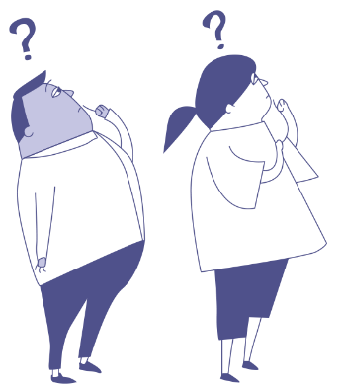
What stops children intervening in bullying situation?
Anti-Bullying Week 2023 – Make a Noise About Bullying

Slide 5
Read and discuss each statement. Then identify what you think are the top three reasons why children don’t intervene in bullying situation in your school?
Anti-Bullying Week 2023 – Make a Noise About Bullying

Slide 6
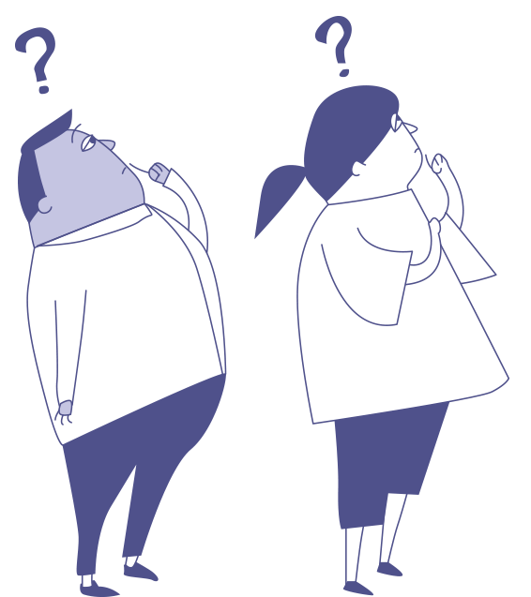
What stops children intervening in bullying situation?
Anti-Bullying Week 2023 – Make a Noise About Bullying
6

Slide 7
Read each bullying intervention card and discuss how likely you would use that specific intervention.
Anti-Bullying Week 2023 – Make a Noise About Bullying

Slide 8
How would you intervene if you saw someone being bullied online or offline?
Anti-Bullying Week 2023 – Speak Out About Bullying
8

Slide 9
Scenario
1
You notice Mira is sitting alone at lunch. Alex starts making fun of Mira’s lunch, saying it looks weird and gross. He begins to laugh and encourages others to join in.
How would you intervene?
Anti-Bullying Week 2023 – Make a Noise About Bullying

Slide 10
Scenario
2
You’re playing an online game with a group of friends. Someone in the group starts saying unkind things towards someone in the group.
How would you intervene?
Anti-Bullying Week 2023 – Make a Noise About Bullying

Slide 11
Scenario
3
Asha is sitting at the back of class with her sketchbook. Jake comes over and grabs her sketchbook, threatening to tear out the pages and starts making fun of her drawings.
How would you intervene?
Anti-Bullying Week 2023 – Make a Noise About Bullying

Slide 12
Scenario
4
Alex and Max used to hang out together every day. But Max joined a new club and made other friends, Alex is now feeling left out.
How would you intervene?
Anti-Bullying Week 2023 – Make a Noise About Bullying

Slide 13
Scenario
5
Carlos is new to the school and is being called unkind names by people you know. During the break, you notice others making fun of him to his face.
How would you intervene?
Anti-Bullying Week 2023 – Make a Noise About Bullying

Slide 15
Our aim is to offer creative youth and community engagement projects that seek to inform, inspire, and empower children and young people in spaces where they live, learn, and play.
For more information contact John Khan
07846137 597
john.khan@priority154.com
www.priority154.com

