Slide 2
GROUP
AGREEMENT
1
Respectful listening
2
Keep it private
3
Ask if you don’t understand
4
No question is too stupid
5
Know my triggers

Slide 3
The importance of friends?
Anti-Bullying Week 2023 – Make a Noise About Bullying

Slide 4
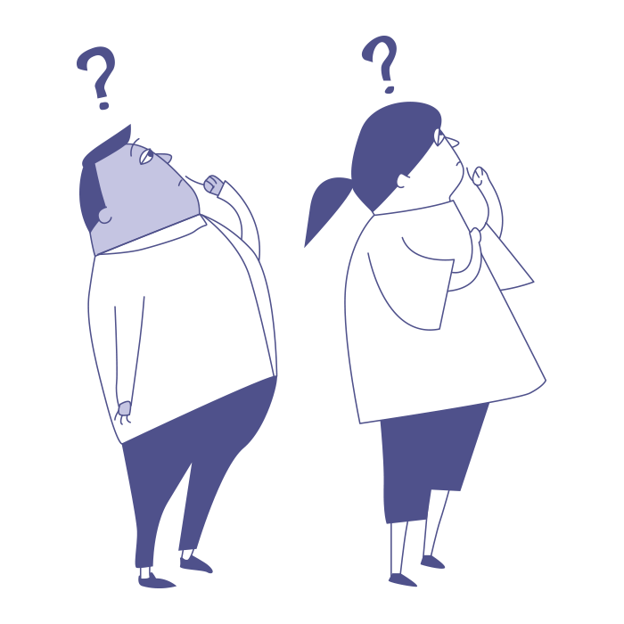
Why are friends important?
Anti-Bullying Week 2023 – Make a Noise About Bullying

Slide 5
What makes a good friends?
Anti-Bullying Week 2023 – Make a Noise About Bullying

Slide 6
How I keep friends survey
Anti-Bullying Week 2023 – Speak Out About Bullying

Slide 7
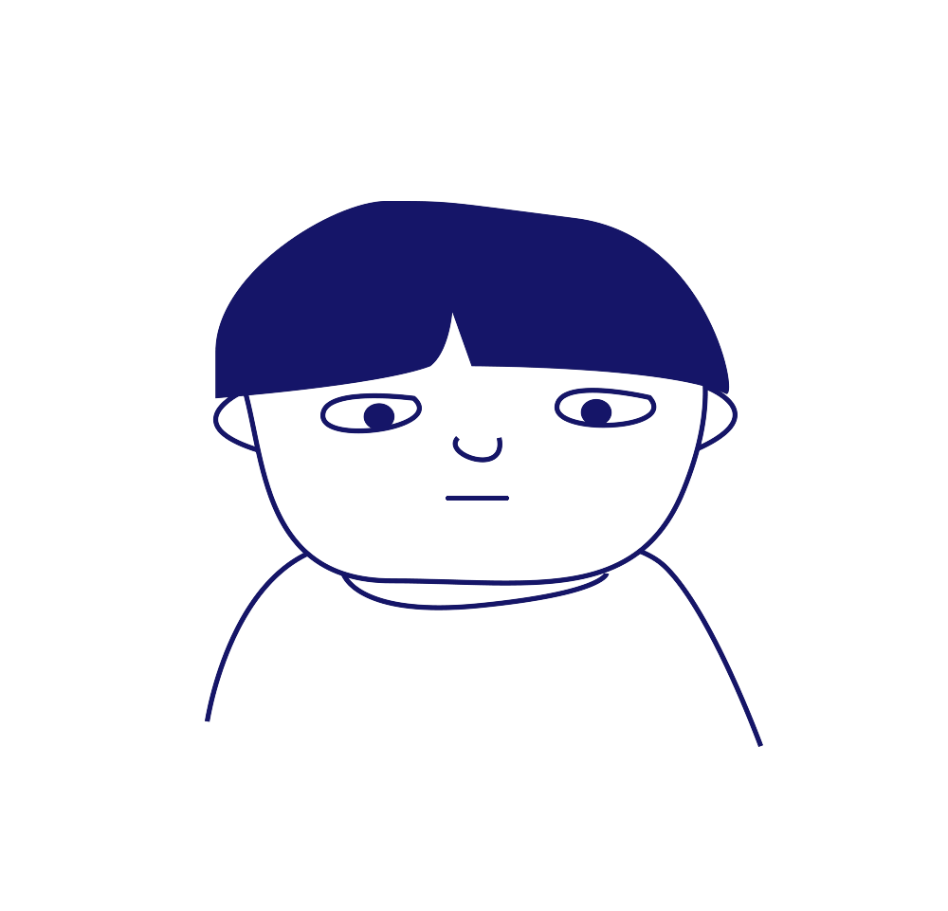
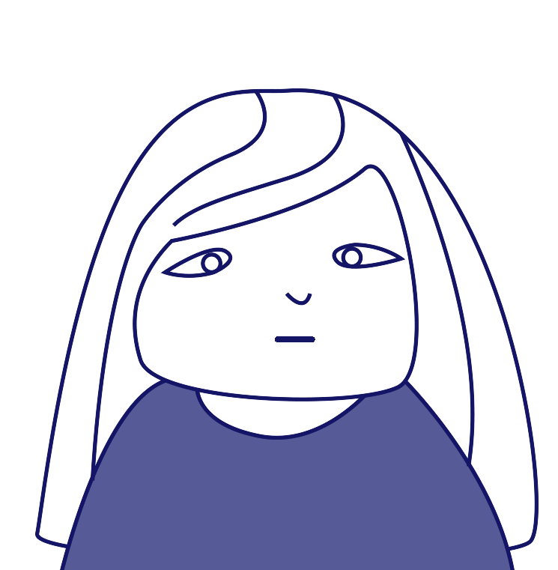
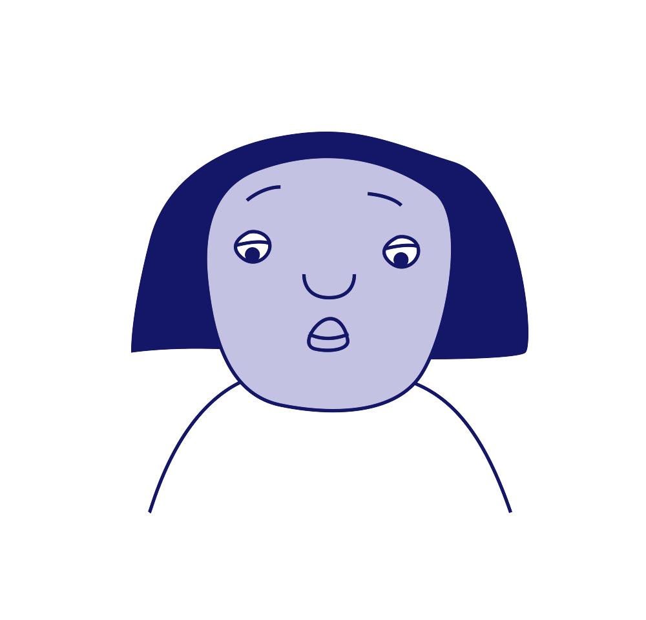
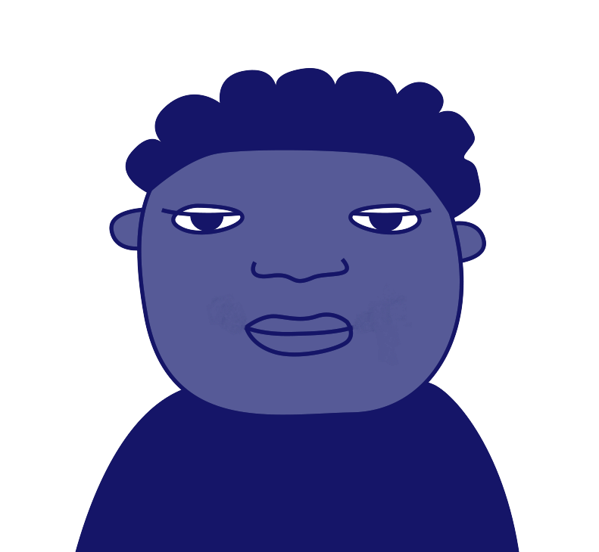
The qualities of a good friend?
Anti-Bullying Week 2023 – Make a Noise About Bullying
Notes:
For this activity, we're going to explore the qualities that make a good friend.
In pairs or small groups, arrange the cards to form a pyramid with the single most important
quality of a friend at the top and the 5 least important qualities at the bottom.

Slide 8
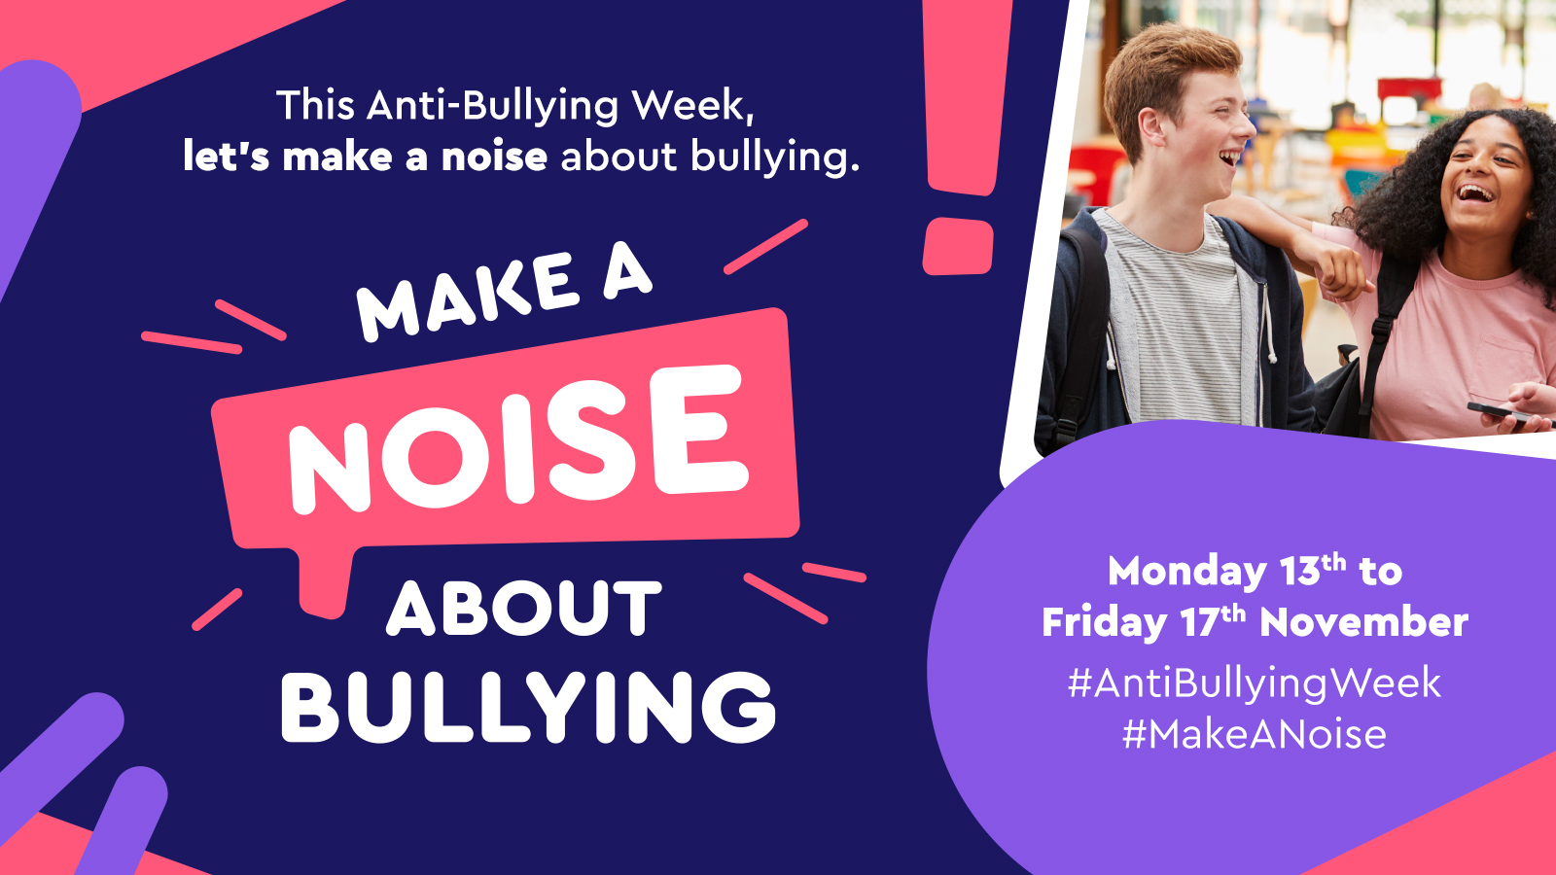

Slide 9
Our aim is to offer creative youth and community engagement projects that seek to inform, inspire, and empower children and young people in spaces where they live, learn, and play.
For more information contact John Khan
07846137 597
john.khan@priority154.com
www.priority154.com

