Slide 1


Slide 2

GROUP
AGREEMENT
Respectful listening
Keep it private
Ask if you don’t understand
No question is too stupid
Know my triggers

Slide 3


Slide 4


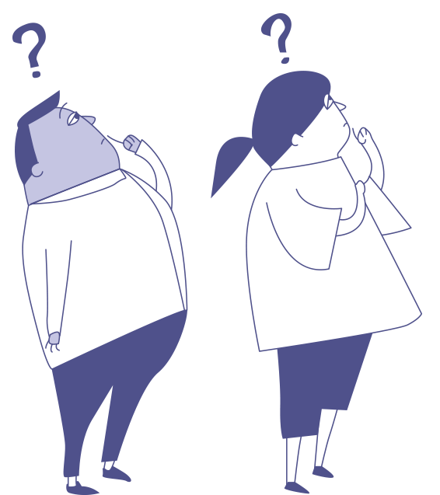
If you had a superpower to help you make a noise about bullying, what would it be?
Anti-Bullying Week 2023 – Make a Noise About Bullying

Slide 5

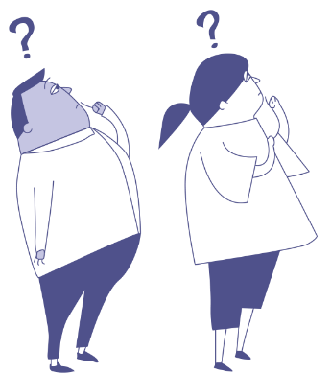
Anti-Bullying Week 2023 – Make a Noise About Bullying
5

Slide 6
Choose Kindness
Anti-Bullying Week 2023 – Make a Noise About Bullying
6

Slide 7


Slide 8
Choose Kindness
Anti-Bullying Week 2023 – Make a Noise About Bullying
8

Slide 9
Can you think why being kind to each other is important?
Anti-Bullying Week 2023 – Make a Noise About Bullying
9

Slide 10
What’s the kindest thing someone has ever said to you?
Anti-Bullying Week 2023 – Make a Noise About Bullying
10

Slide 11

When was the last time somebody…
gave you a compliment?
included you?
asked how you are?
smiled at you?
helped you out?
Pair share
When was the last time these things happened to you?
How did it make you feel??
Anti-Bullying Week 2023 – Make a Noise About Bullying

Slide 12
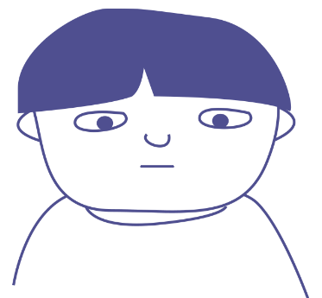
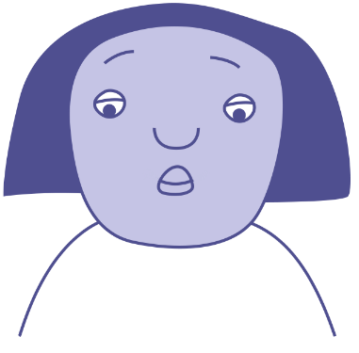

What could you do?
Max is not himself today. He has hardly said a word.
Smile
Compliment them
Laugh
Find an adult
You hear someone saying something nasty to Grace in the playground.
Sit with them
Walk away
Ask if they are OK
Invite them to join
You hear snuffles coming from one of the toilets. It sounds like crying.
Ignore them
Ask if you can help
Anti-Bullying Week 2023 – Make a Noise About Bullying

Slide 13

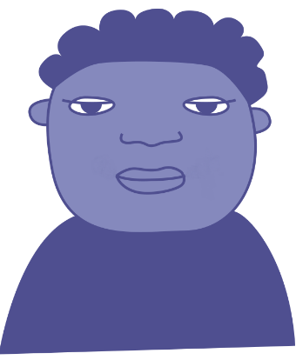
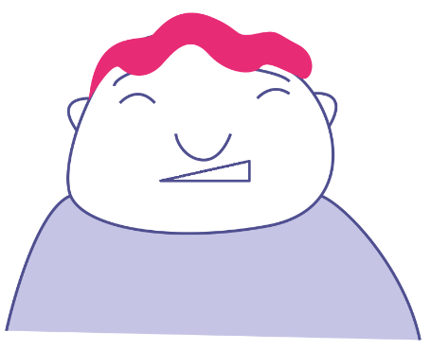
What could you do?
Faiza is reading a message on her phone. She looks worried.
Smile
Compliment them
Laugh
Find an adult
Jasmine is sitting on her own at lunch. She looks lonely.
Sit with them
Walk away
Ask if they are OK
Invite them to join
A pupil from another class is wandering around with no one to play with.
Ignore them
Ask if you can help
Anti-Bullying Week 2023 – Make a Noise About Bullying

Slide 14

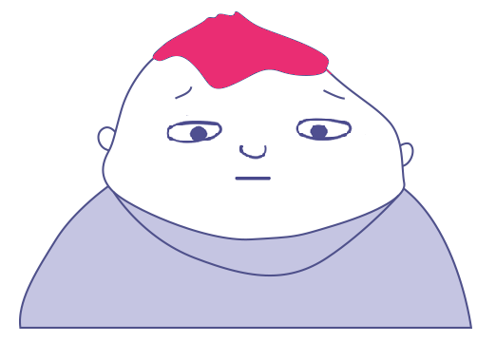

What could you do?
You see your friend push someone & say, ‘You can’t play with us’ to another pupil.
Smile
Compliment them
Laugh
Find an adult
Someone makes a joke about Isaac. He doesn’t laugh and looks upset.
Sit with them
Walk away
Ask if they are OK
Invite them to join
Someone sends a mean message to you about a person in your class.
Ignore them
Ask if you can help
Anti-Bullying Week 2023 – Make a Noise About Bullying

Slide 15
Change starts with individual
acts of kindness
Anti-Bullying Week 2023 – Make a Noise About Bullying

Slide 16


Slide 17





Our aim is to offer creative youth and community engagement projects that seek to inform, inspire, and empower children and young people in spaces where they live, learn, and play.
For more information contact John Khan
07846137 597
john.khan@priority154.com
www.priority154.com

