Slide 1


Slide 2
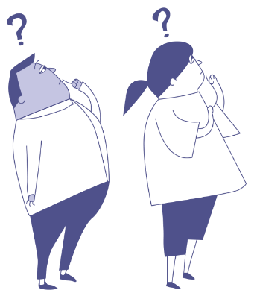
Bystander Behaviour
Anti-Bullying Week 2023 – Make a Noise About Bullying
2

Slide 3

GROUP
AGREEMENT
Respectful listening
Keep it private
Ask if you don’t understand
No question is too stupid
Know my triggers

Slide 4


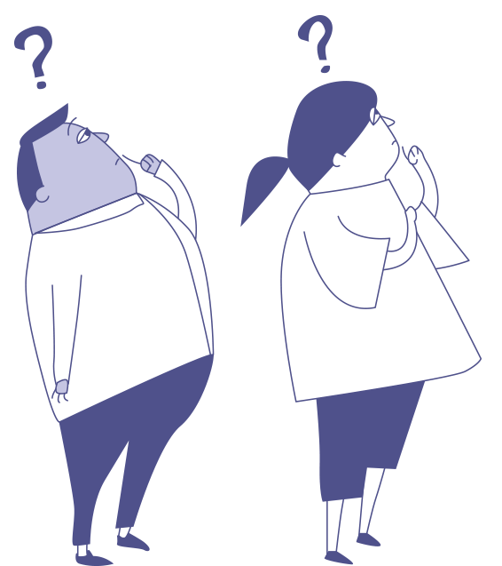
What is a bystander?
Anti-Bullying Week 2023 – Make a Noise About Bullying
4

Slide 5
What is Upstander?
Anti-Bullying Week 2023 – Make a Noise About Bullying
5

Slide 6
?
Can you think of any famous UPstanders?
Anti-Bullying Week 2022 – Reach out
6

Slide 7
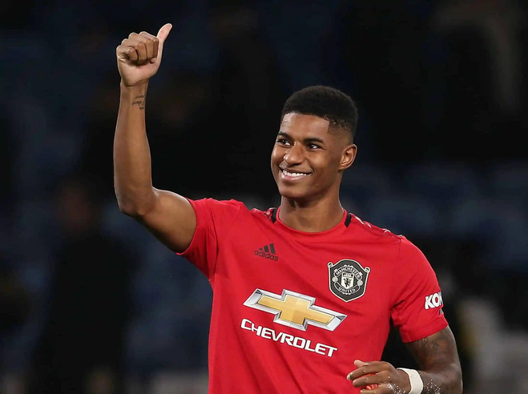
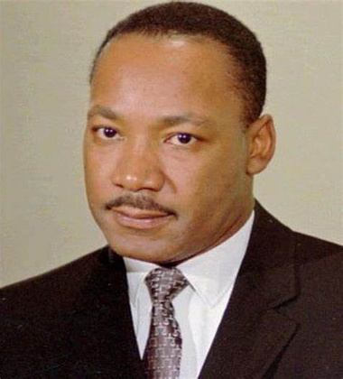
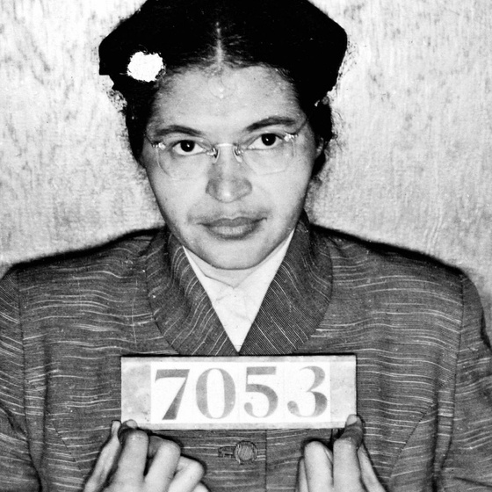
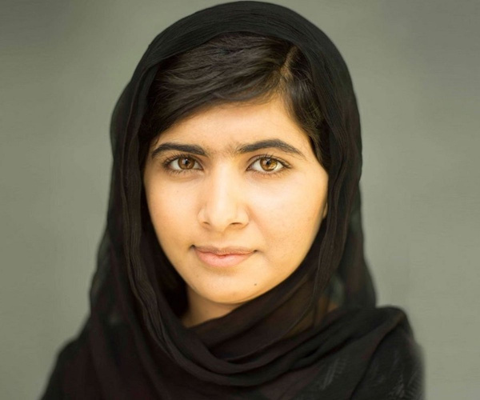
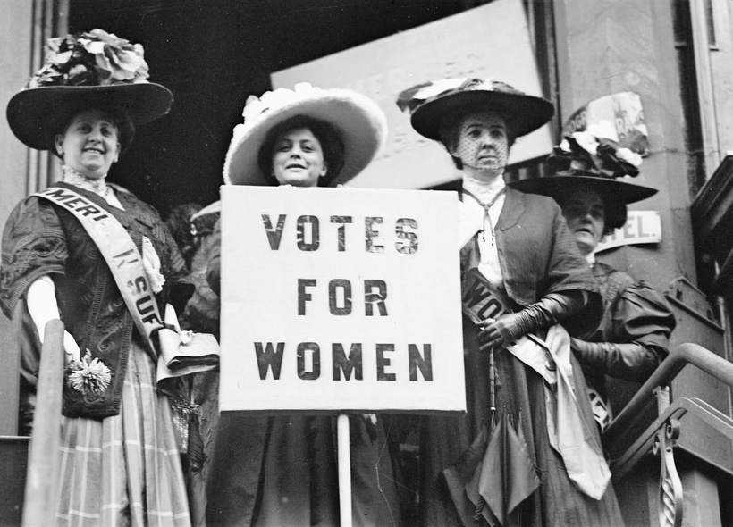
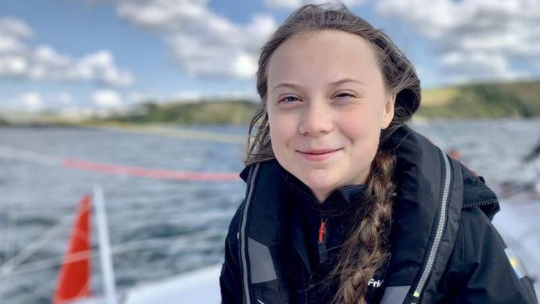

Slide 8
Who might be involved in a bullying incident?
How many people?
What are they doing?

Slide 9

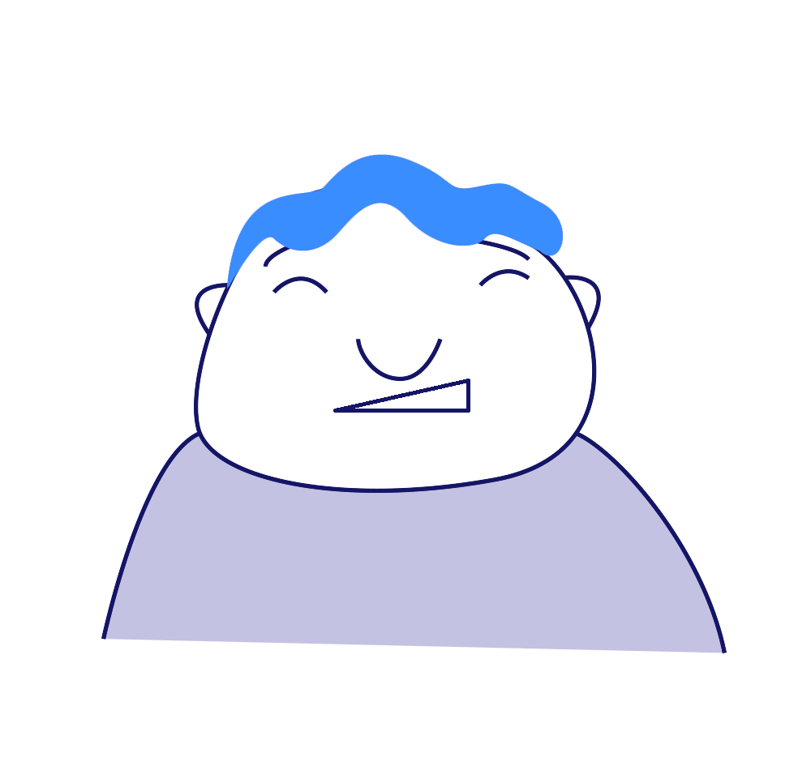
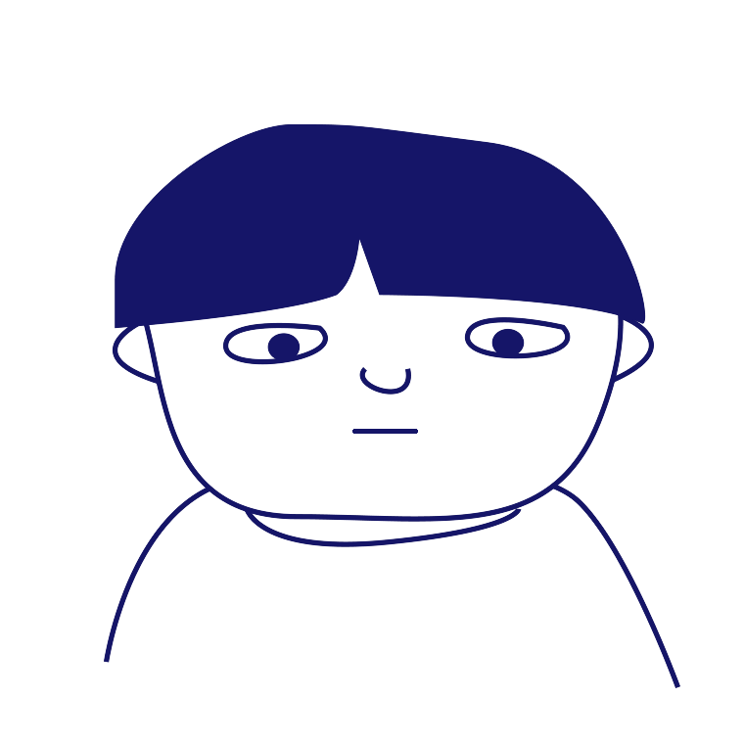
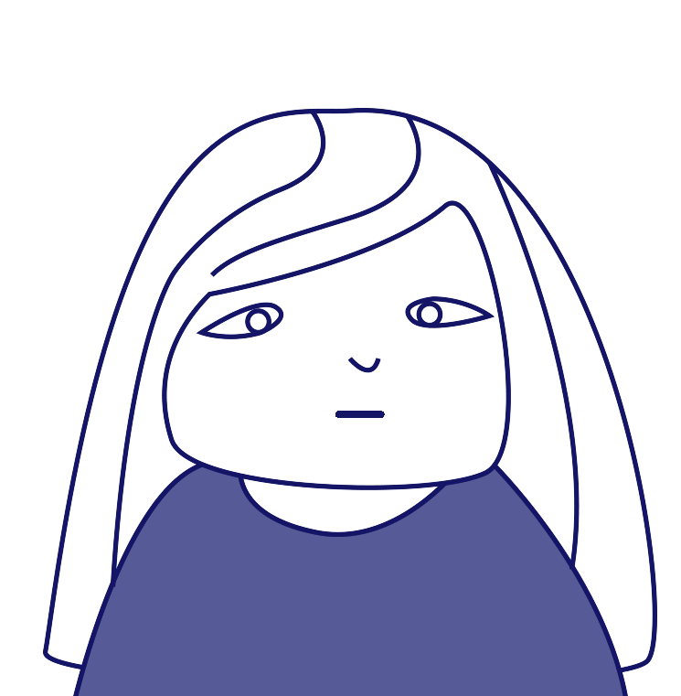
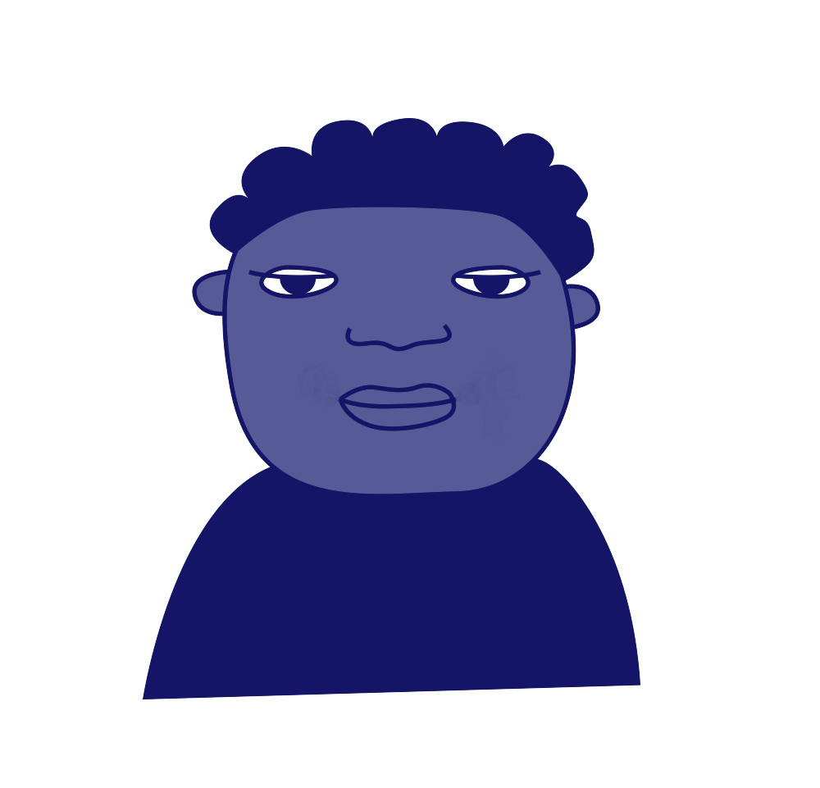
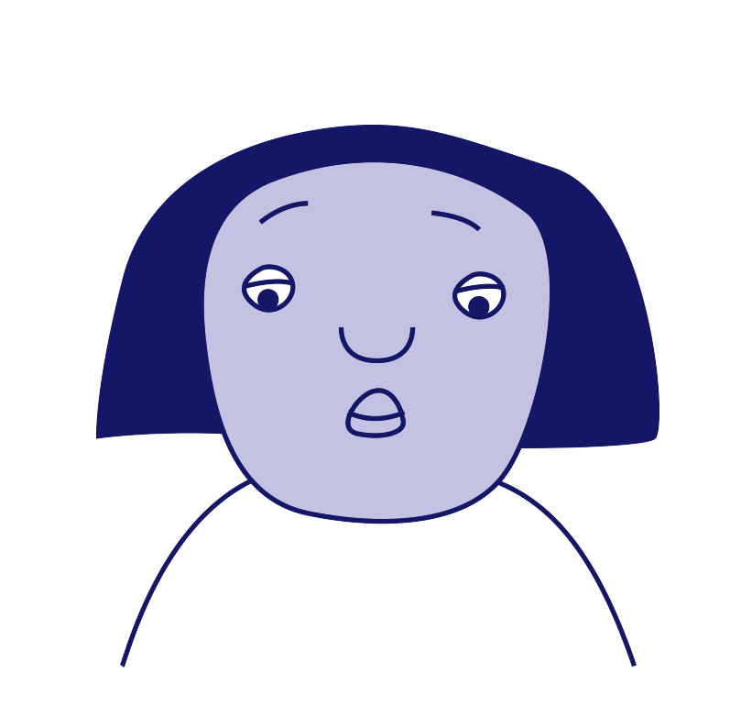
Roles involved in bullying
‘Ringleader’
‘Assistant’
‘Target’
‘Outsider’
or
‘Bystander’
‘Defender/
Upstander’
‘Reinforcer’

Slide 10
Scenario
1
Every time Rhys goes onto the field at break time, a group of girls follow him around and are unkind to him. Two of them shout names and make fun of his hair, and the rest of them watch and laugh along.
Which roles can you see in this scenario? How could each person reach out?
Notes:
In print mode, print off slide 9 as A4 page and hand this out to children so they can refer to the difference roles in a bullying situation.

Slide 11
Scenario
2
Whenever Jenni joins an online game on her PlayStation with her classmates, Dylan always tells other children to leave the game and start a new one without her.
Which roles can you see in this scenario? How could each person reach out?

Slide 12
Scenario
3
Jac is often told by Sofia to spread unkind rumours about Amelia on WhatsApp.
Which roles can you see in this scenario? How could each person reach out?

Slide 13


Slide 14





Our aim is to offer creative youth and community engagement projects that seek to inform, inspire, and empower children and young people in spaces where they live, learn, and play.
For more information contact John Khan
07846137 597
john.khan@priority154.com
www.priority154.com

