Slide 1


Slide 2
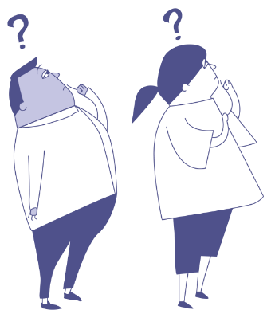
Defining bullying behaviour
Anti-Bullying Week 2023 – Make a Noise About Bullying
2

Slide 3

GROUP
AGREEMENT
Respectful listening
Keep it private
Ask if you don’t understand
No question is too stupid
Know my triggers

Slide 4


Can you think what the children and young people in green represent?
30% of children in England said they had been bullied in the last year
4

Slide 5
One child in every classroom experiences bullying each day
5

Slide 6


Slide 7
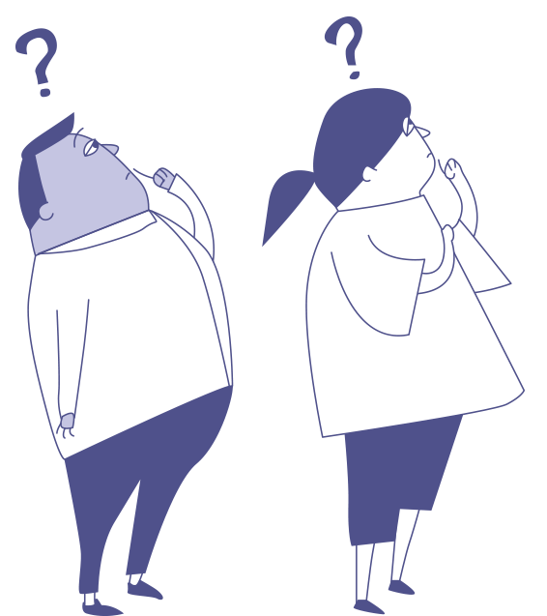
If you had a superpower to help you make a noise about bullying, what would it be?
Anti-Bullying Week 2023 – Make a Noise About Bullying

Slide 8
What is bullying?
Anti-Bullying Week 2023 – Make a Noise About Bullying
8

Slide 9
Four key words…
R =
I =
H =
P =
Repetitive (repeated)
Intentional (deliberate)
Hurtful
Imbalance of power
Anti-Bullying Week 2023 – Make a Noise About Bullying
9

Slide 10
“
Bullying is the repetitive, intentional hurting of one person or group by another person or group, where there is an imbalance of power.
“
Video: https://www.youtube.com/watch?v=U8iX-rstY9I
Anti-Bullying Week 2023 – Make a Noise About Bullying

Slide 11
Imbalance of power
Insult!
Insult!
Is there an imbalance of power?
Stop it!
Insult!
Is there an imbalance of power?
Insult!
Insult!
Insult!
Insult!
Insult!
Insult!
Stop it! All of you! It’s not true!!
Rumour spread
Is there an imbalance of power?

Slide 12
Can you identify other types of imbalances of power in bullying situations?
Anti-Bullying Week 2023 – Make a Noise About Bullying
12

Slide 13


Bigger person bullying a smaller person

Slide 14


A group of people bullying an individual

Slide 15
What are the four main types of bullying behaviour?
Anti-Bullying Week 2023 – Make a Noise About Bullying

Slide 16
Types of bullying
Verbal
Physical
Indirect
Cyberbullying
name-calling, insults, teasing, intimidation, homophobic or racist remarks, or verbal abuse.
includes hitting, kicking, tripping, pinching, pushing, or damaging property.
spreading rumours, excluding or ostracising someone from a group, or embarrassing someone in public.
using technology to harass, intimidate, or embarrass someone.
Anti-Bullying Week 2023 – Make a Noise About Bullying

Slide 17
Scenario
1
Sophie and Emma attend the same after school club. Sophie often ignore Emma and leaves her out of group activities.
Is this bullying?
Anti-Bullying Week 2023 – Make a Noise About Bullying

Slide 18
Scenario
2
Yaz and Jake used to be friends, but recently, Yaz has started spreading rumours about Jake, saying that he's not a good football player. Jake feels hurt and excluded.
Is this bullying?
Anti-Bullying Week 2023 – Make a Noise About Bullying

Slide 19
Scenario
3
Amy frequently makes fun of Sara's glasses in front of their friends. She often teases Sara about her appearance, and Sara feels embarrassed and upset.
Is this bullying?
Anti-Bullying Week 2023 – Make a Noise About Bullying

Slide 20
How can you ‘Make A Noise About Bullying’?
Anti-Bullying Week 2023 – Make a Noise About Bullying

Slide 21


Slide 22





Our aim is to offer creative youth and community engagement projects that seek to inform, inspire, and empower children and young people in spaces where they live, learn, and play.
For more information contact John Khan
07846137 597
john.khan@priority154.com
www.priority154.com

