Slide 2
Reporting versus Snitching
Anti-Bullying Week 2023 – Make a Noise About Bullying
2

Slide 3
GROUP
AGREEMENT
1
Respectful listening
2
Keep it private
3
Ask if you don’t understand
4
No question is too stupid
5
Know my triggers

Slide 4
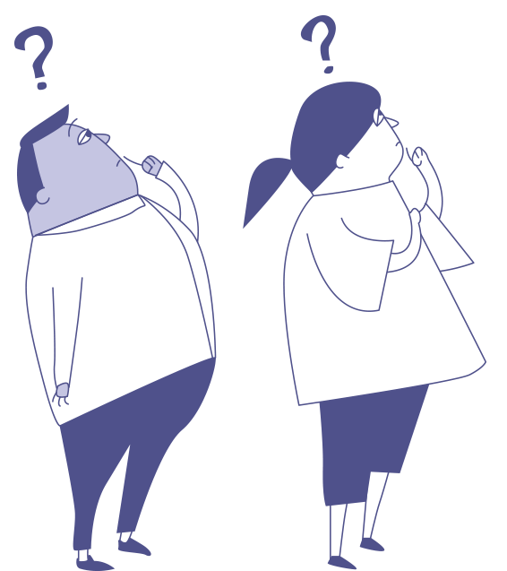
Can you say what the difference is between reporting and snitching (grassing)?

Slide 5
Snitching (or grassing) is about getting someone into trouble when no one is being hurt
Reporting is about keeping people safe from harm.

Slide 6
What stops children from reporting bullying or unkind behaviour, when they see it?
Anti-Bullying Week 2023 – Make a Noise About Bullying

Slide 7
If you were observing the following situations, would you tell an adult?
Anti-Bullying Week 2023 – Make a Noise About Bullying

Slide 8
Scenario
1
At the back of class, Jasmine makes a face at the teacher when her back is turned to the board.
Are you telling?

Slide 9
Scenario
2
Someone in Alice’s class is spreading unkind rumours about her on social media.
Are you telling?

Slide 10
Scenario
3
At lunchtime, Robbin does not drink all his milk and throws it away.
Are you telling?

Slide 11
Scenario
4
Sash decides he can ride his bike home from school on his own even though his parents have said he shouldn’t.
Are you telling?

Slide 12
Scenario
5
At home, Mark lets the dog outside onto the main road without a lead.
Are you telling?

Slide 13
How does it feel to ‘Make A Noise’ about something that really matters to you?
Anti-Bullying Week 2023 – Make a Noise About Bullying

Slide 15
Our aim is to offer creative youth and community engagement projects that seek to inform, inspire, and empower children and young people in spaces where they live, learn, and play.
For more information contact John Khan
07846137 597
john.khan@priority154.com
www.priority154.com

