Slide 1


Slide 2
When banter turns to bullying
Anti-Bullying Week 2023 – Make a Noise About Bullying

Slide 3

GROUP
AGREEMENT
Respectful listening
Keep it private
Ask if you don’t understand
No question is too stupid
Know my triggers

Slide 4



What is banter?
Anti-Bullying Week 2023 – Make a Noise About Bullying

Slide 5
‘The playful and friendly exchange of teasing remarks.’
Anti-Bullying Week 2023 – Make a Noise About Bullying

Slide 6
Banter between with friends can…
Be light-hearted and a fun way to pass time
Make you feel closer to each other
Show acceptance in a friend group
Show you trust each other
Anti-Bullying Week 2023 – Make a Noise About Bullying

Slide 7
What does online banter look like?
Anti-Bullying Week 2023 – Make a Noise About Bullying

Slide 8
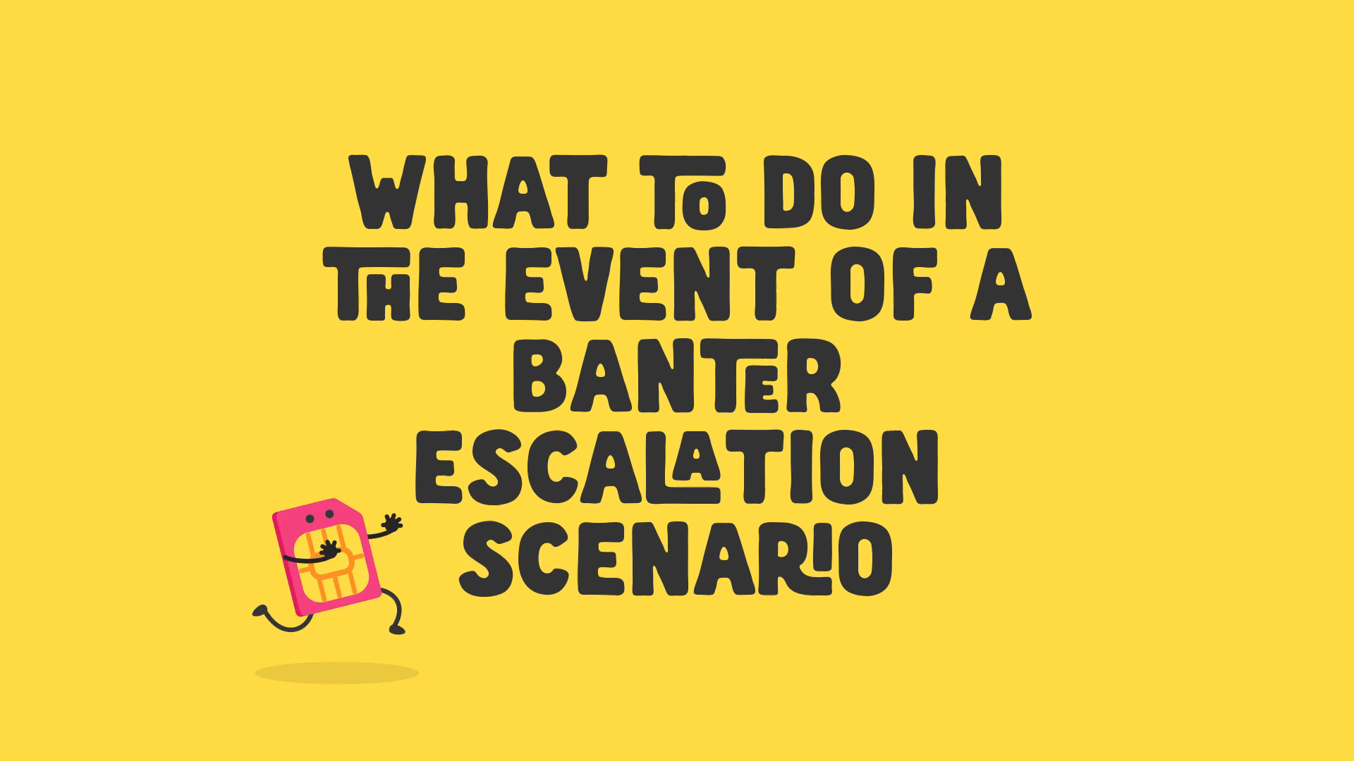
Anti-Bullying Week 2023 – Make a Noise About Bullying

Slide 9
When does banter turn to bullying?
Anti-Bullying Week 2023 – Make a Noise About Bullying

Slide 10
Friendly
banter
Ignorant
banter
Hurtful
banter
Everyone
knows the limits
‘Crosses the line’
or when things
go too far
Done deliberately
to hurt someone
Anti-Bullying Week 2023 – Make a Noise About Bullying

Slide 11
The topic
Repeated
Relationships
What other things turns banter into bullying behaviour?
Intention
Reaction
Where it happens
Anti-Bullying Week 2023 – Make a Noise About Bullying

Slide 12


Slide 13





Our aim is to offer creative youth and community engagement projects that seek to inform, inspire, and empower children and young people in spaces where they live, learn, and play.
For more information contact John Khan
07846137 597
john.khan@priority154.com
www.priority154.com

