Slide 2
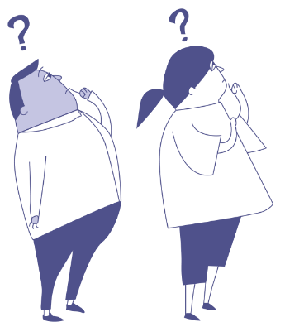
Anti-Bullying Week 2023 – Make a Noise About Bullying
2

Slide 4
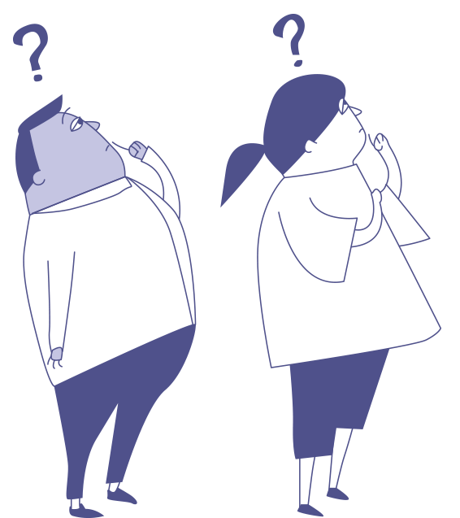
If you had a superpower to help you make a noise about bullying, what would it be?
Anti-Bullying Week 2023 – Make a Noise About Bullying

Slide 6
Can you think why being kind to each other is important?
Anti-Bullying Week 2023 – Make a Noise About Bullying
6

Slide 7
What’s the kindest thing someone has ever said to you?
Anti-Bullying Week 2023 – Make a Noise About Bullying
7

Slide 8
When was the last time somebody…
gave you a compliment?
included you?
asked how you are?
smiled at you?
helped you out?
Pair share
When was the last time these things happened to you?
How did it make you feel??
Anti-Bullying Week 2023 – Make a Noise About Bullying

Slide 9
Change starts with individual
acts of kindness
Anti-Bullying Week 2023 – Make a Noise About Bullying

Slide 11
Our aim is to offer creative youth and community engagement projects that seek to inform, inspire, and empower children and young people in spaces where they live, learn, and play.
For more information contact John Khan
07846137 597
john.khan@priority154.com
www.priority154.com

